Slide 1
North America The Continent Series
VMS Library 2008-2009

Slide 2
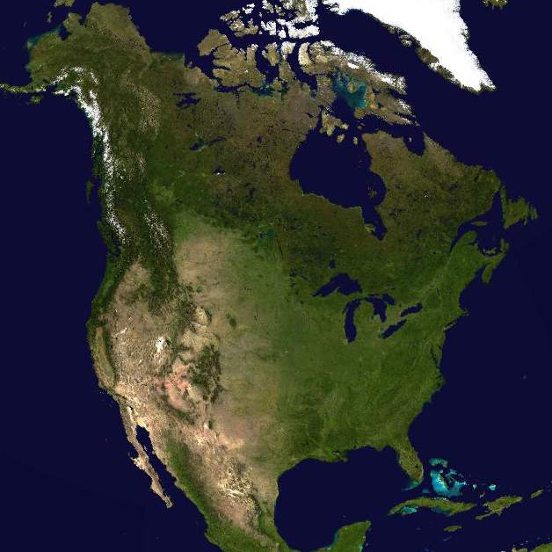
Satellite View

Slide 3
Longitude / Latitude

Slide 4
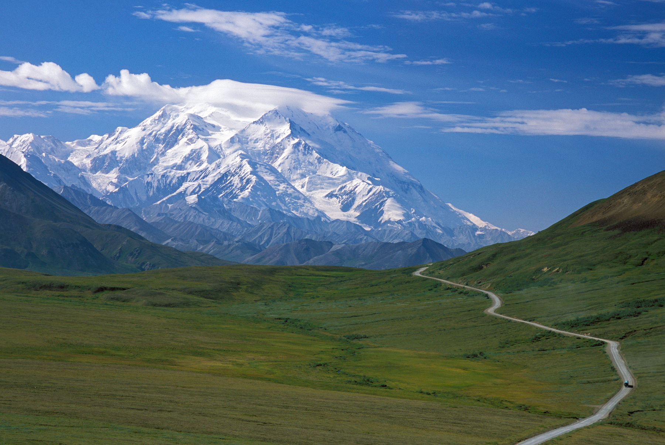
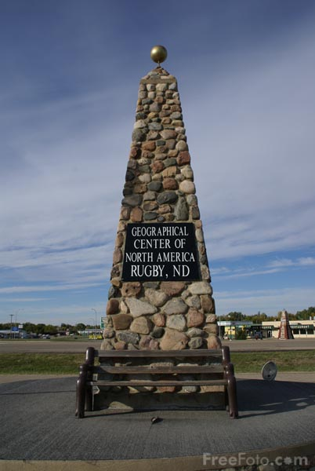
Unique features
Highest peak is Denali, Alaska
Rugby, North Dakota
center point of
North America

Slide 5
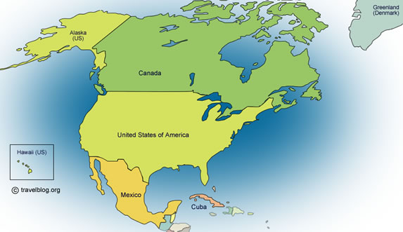
North America’s Size
4.8% of the earth’s surface
3rd largest continent
4th largest in population

Slide 6
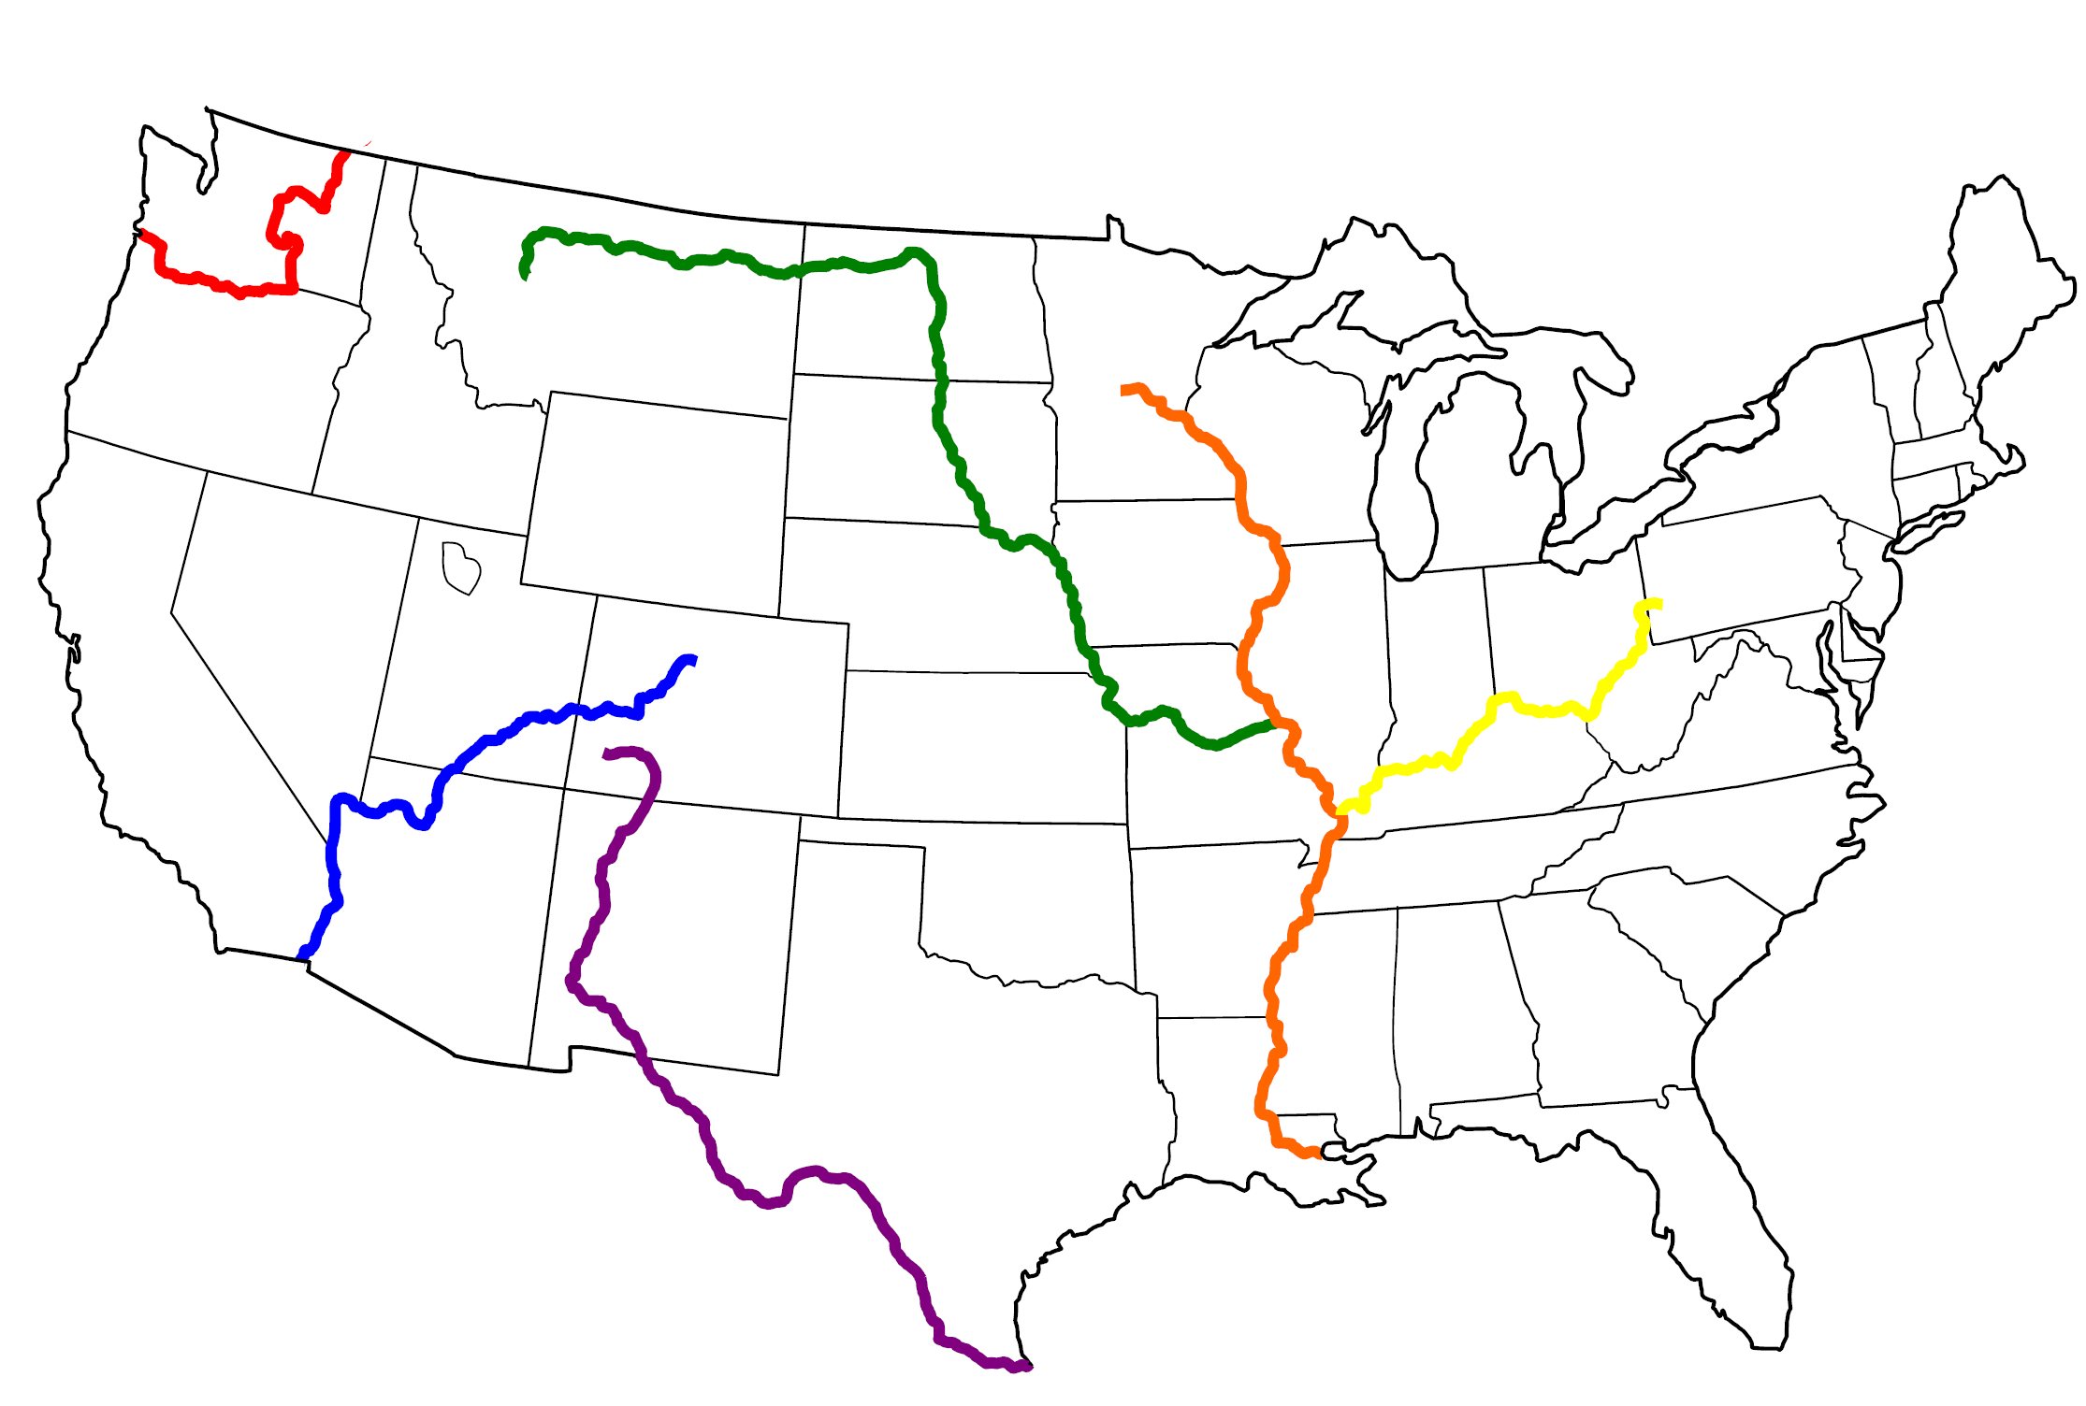
Bodies of water
Columbia River
Colorado River
Rio Grande
Missouri River - longest
Mississippi River
Ohio River
Missouri/Mississippi River is
3,879 miles long

Slide 7
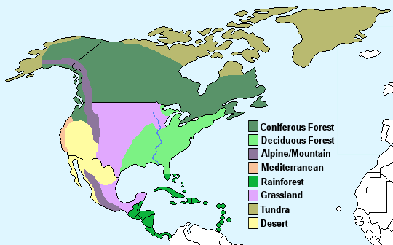
Climate

Slide 8
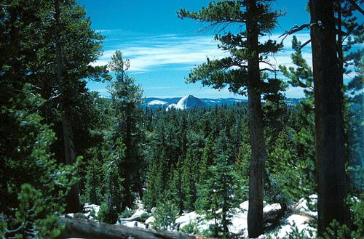
Coniferous Forests
Upper area of North America
Pines, fir and spruce trees, produce cones which contains the seeds
Tall mountains have supported tree growth
Cold and stormy in the winter
Lightening storms in the summer

Slide 9
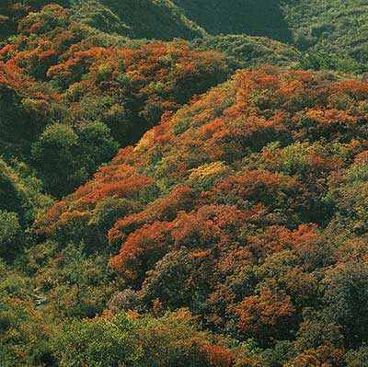
Deciduous Forest
They are found 0 - 50° degrees north latitude
Former glaciers from New England to Indiana
Moderate climate, 4 seasons and they get 2 - 4 feet of rain per year
Trees are oaks, maples, beeches, hickories and ashes

Slide 10
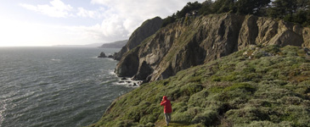
Mediterranean Region
Hot, dry summers, mild, wet winters
Only found in 5 places on Earth
California, Northern Baja, California
Basin of the Mediterranean Sea
Southwestern Australia
Western cape of South Africa
Central Cost of Chile

Slide 11
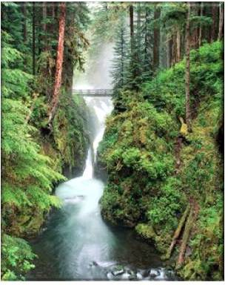
Rainforest
North America contains the largest continuous area of costal temperate rainforest in the world
Oregon to Alaska
350 species of animals
25 tree species
55 inches of rainfall p/y

Slide 12
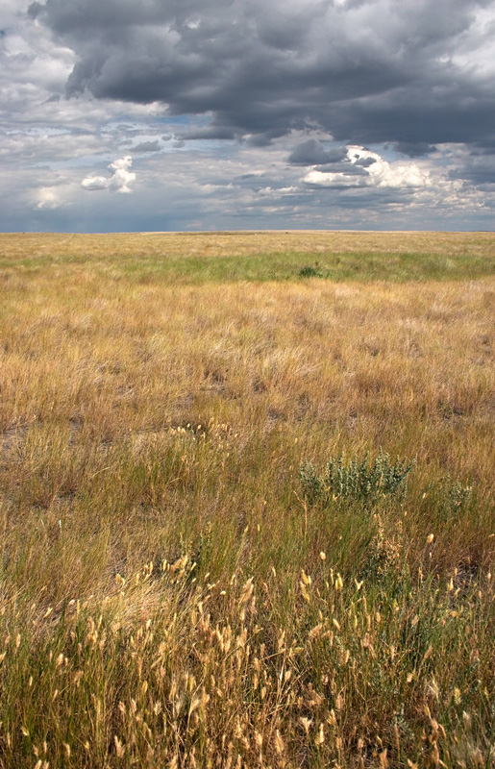
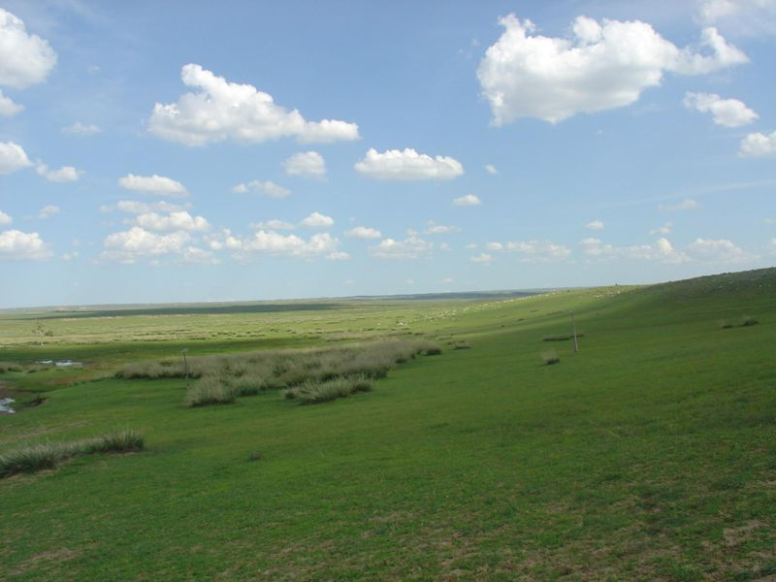
Grassland
2-35 inches of rainfall p/y
Summer temperatures 100°F
Winter temperatures 0°F

Slide 13
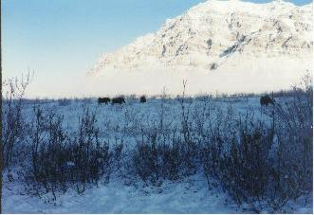
Tundra
55° to 70° North
Tundra means barren land
Ground is permanetly frozen 10” to 3 ft.
Average temperature -18°F
Summer the sun never sets
Worlds’ coldest/driest biome

Slide 14
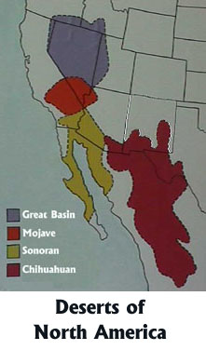
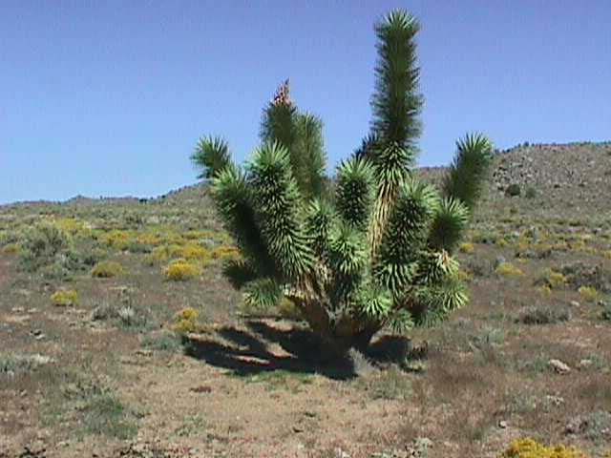
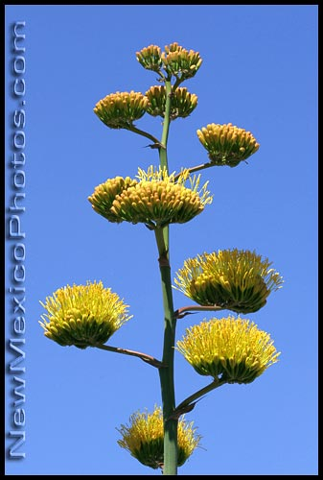
Desert
There four specific regions
Sonoran Desert found in California, Arizona and Mexico. Low elevation which makes it HOT
Mojave Desert – the smallest, but where Death Valley can reach 134°
Joshua Tree►
Chihuahuan Desert – found in Mexico, it gets 8-12 inches of rain per year. Century Plant►
Great Basin – Nevada with Mountain ranges over 10,000 feet, 4- 11 inches of snow a year

Slide 15
This powerpoint was kindly donated to www.worldofteaching.com
http://www.worldofteaching.com is home to over a thousand powerpoints submitted by teachers. This is a completely free site and requires no registration. Please visit and I hope it will help in your teaching.

